Slide 1







THE RESTAURANT WEBSITE

Slide 2


OUR TEAM
Group Leader: Syed Ikrash Ahmed 24K-0998
Syeda Fatima Waseem 24K-0924
Hafsa Ayubi 24K-0846

Slide 3



INTRODUCTION
An online menu website for a restaurant using HTML and CSS. The website will display a list of all the available dishes and their prices, and the dishes will be sorted
according to different categories.
A reservation form will allow customers to reserve their orders through the website. Project aims to simplify the restaurant customer engagement process and save time for both the staff and customers by providing a smooth reservation process and a menu.

Slide 4

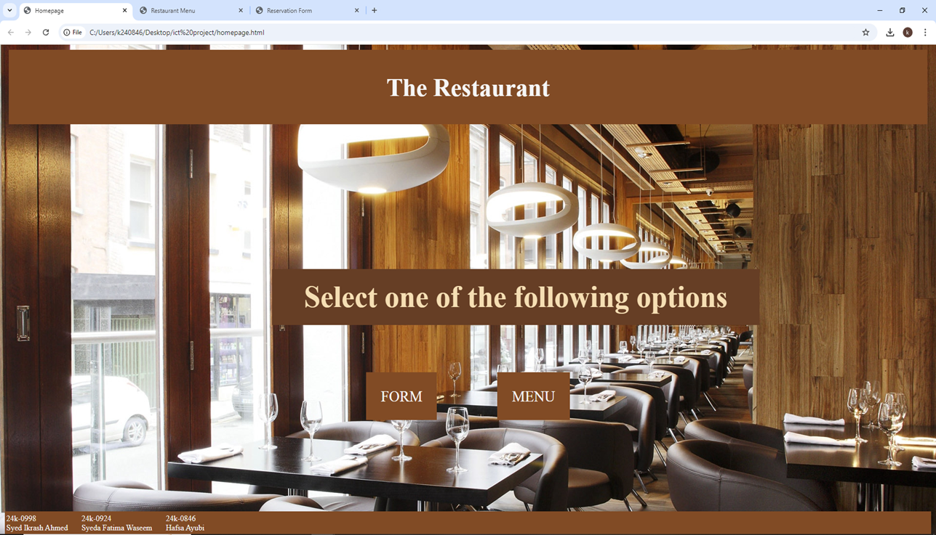
HOMEPAGE
•HEADER
•Background image
•2 buttons for form & menu
•Footer

Slide 5

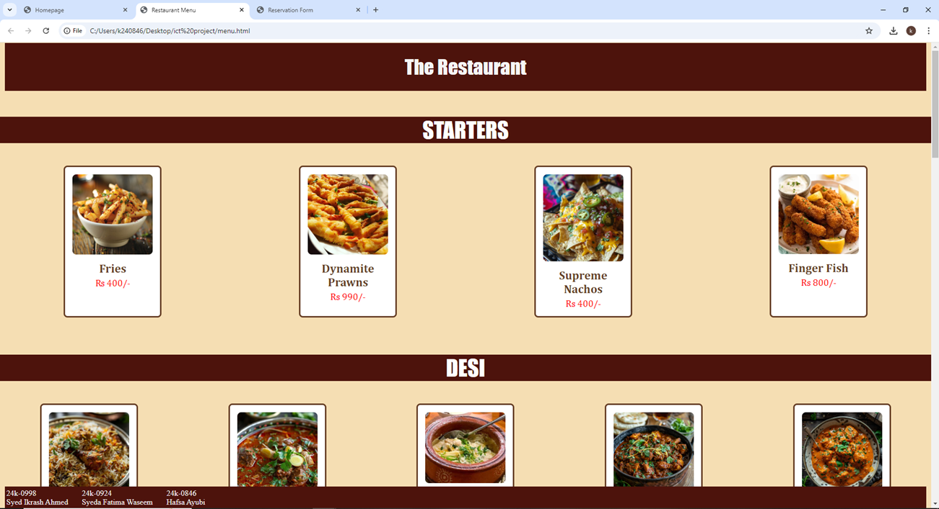
MENU
•HEADER
•Background color
•Each menu section heading
•Name and price of
each menu item
•Image for each menu item
•Footer

Slide 6
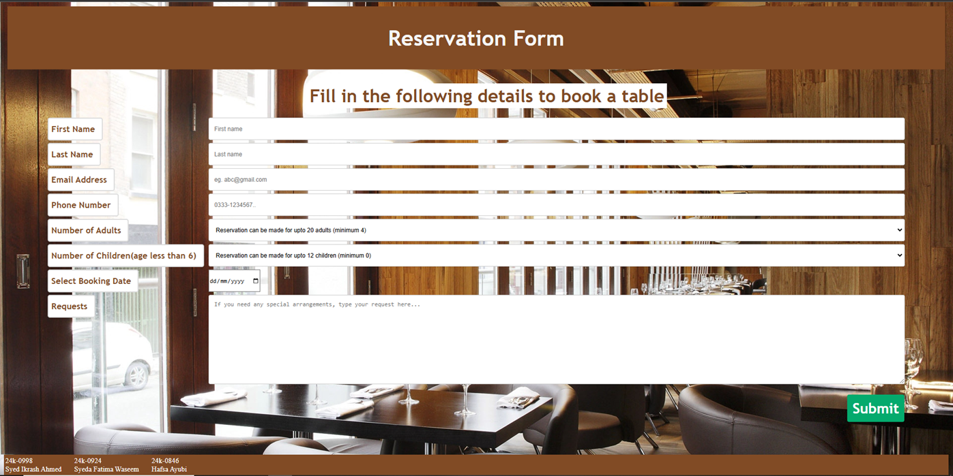
RESERVATION FORM
•HEADER
•Background image
•Label column
•Input column
•Submit button
•Footer

Slide 7
REFERENCES
•W3SCHOOLS
•Kababjees
•Lal qila (form)
WWW.W3SCHOOLS.COM
www.order.kababjees.com
www.lalqila.com

Slide 8

THANK YOU
SO MUCH

